Slide 1
Karnataka State

Slide 2
Issues
Develop SDG Dashboard at State level on GP SDG indicators
Capacity building training at District, Taluka and GP level for officers and staffs
Incentivization on SDGs and for recognition of efforts by Gram Panchayats/Talukas and Districts those who achieve the Sustainable Development Goals (Model as per Central Government incentives to the Aspirational districts)
Appointment of SDG Nodal officers at District/Taluk/Gram Panchayat level

Slide 3
NITI Aayog Localization of SDGs
29 subjects that are the responsibility of the Gram Panchayats cover the SDGs with varying levels of devolution in different States
Skills and competencies of the department functionaries and ERs and orientation to the breadth, depth and universality of SDGs for people, planet, prosperity with peace and partnership
Flagship schemes and multitude of schemes of Central and State Governments have substantial impact on SDGs, and are implemented in rural areas
Schemes focus on scheme objectives and achievements, with progress as measured in financial and physical terms under the scheme MoPR – responsible for SDG Localisation
Planning and Programme Monitoring and Statistics Department as Nodal department for monitoring and coordination

Slide 4
Performance of Karnataka – SDG India Index 2020-21
Category (Score) | SDG Goal | 2020-21 | 2020-21
 |  | Score out of 100 | Best Performing State
Achiever (100) | SDG 7: Affordable and Clean Energy | 100 | Karnataka 100
Front Runner (65-99) | SDG 1: No Poverty | 68 | TN 86
 | SDG 3: Good Health and Well-being | 78 | Gujarat 86
 | SDG 6: Clean Water and Sanitation | 85 | Goa 100
 | SDG 8: Decent Work and Economic Growth | 66 | HP 78
 | SDG 12: Responsible consumption and production | 89 | Tripura 99
 | SDG 10: Reduced Inequalities | 67 | Meghalaya 88
 | SDG 11: Sustainable Cities and Communities | 78 | Punjab 91
 | SDG 15: Life on Land | 67 | Arunachal Pradesh 93
 | SDG 16: Peace, Justice and Strong Institutions | 76 | Uttarakhand 86
Performer (50-64) | SDG 2: Zero Hunger SDG 4: Quality Education SDG 5: Gender Equality SDG 9: Industry, Innovation and Infrastructure SDG 13: Climate action SDG 14: Life below water | 53 | Kerala 80
 |  | 64 | Kerala 80
 |  | 57 | Chhattisgarh 64
 |  | 64 | Gujarat 72
 |  | 62 | Orissa 70
 |  | 60 | Orissa 82
 | All Goals- Karnataka | 72 | Kerala 75

Slide 5
As per CODR Analysis
(Sustainable Development Goals (SDG) | The number of talukas below the State average
SDG-1 - Poverty Alleviation | 91
SDG-2 - Hunger Free | 104
SDG-3 - Good Health | 123
SDG-4 - Quality Education | 94
SDG-5 - Gender Equality | 112

Slide 6
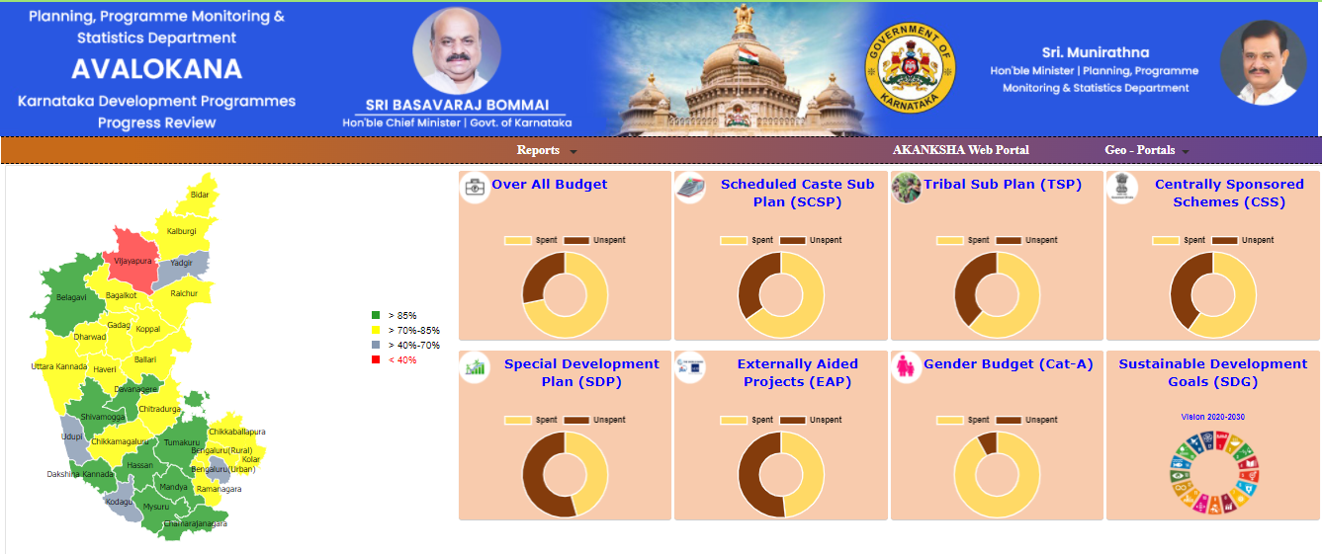
Avalokana - https://avalokana.karnataka.gov.in/
Avalokana platform will enable citizens to access data on budget and expenditures incurred by all 39 departments on 1,800+ programmes implemented by government.
The platform also serves as a Dashboard for SDGs

Slide 7
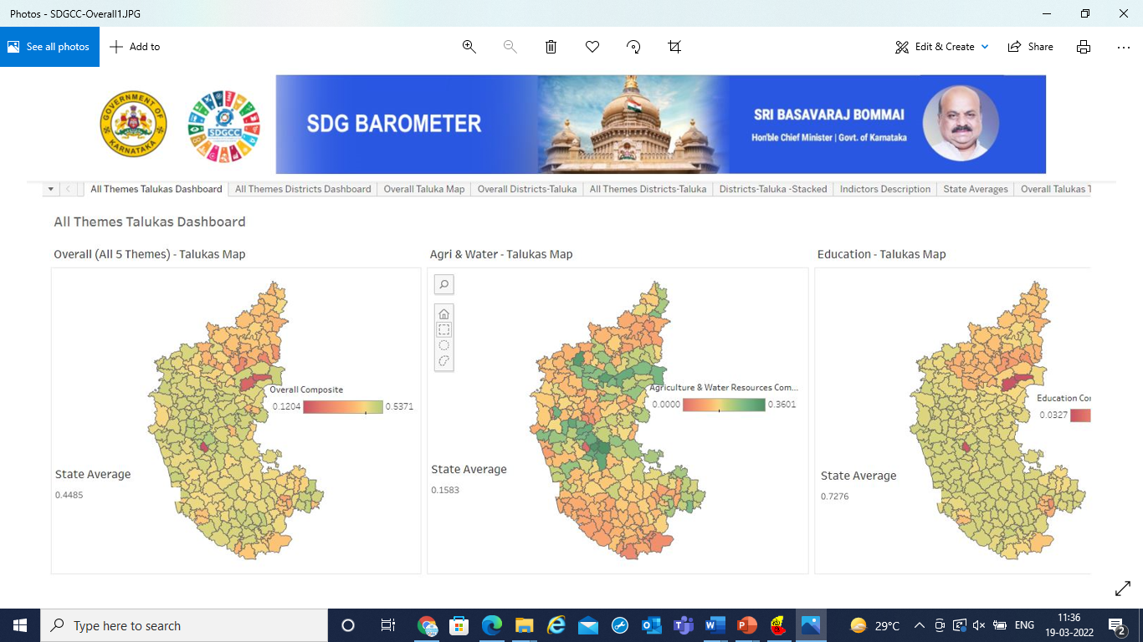

Slide 8
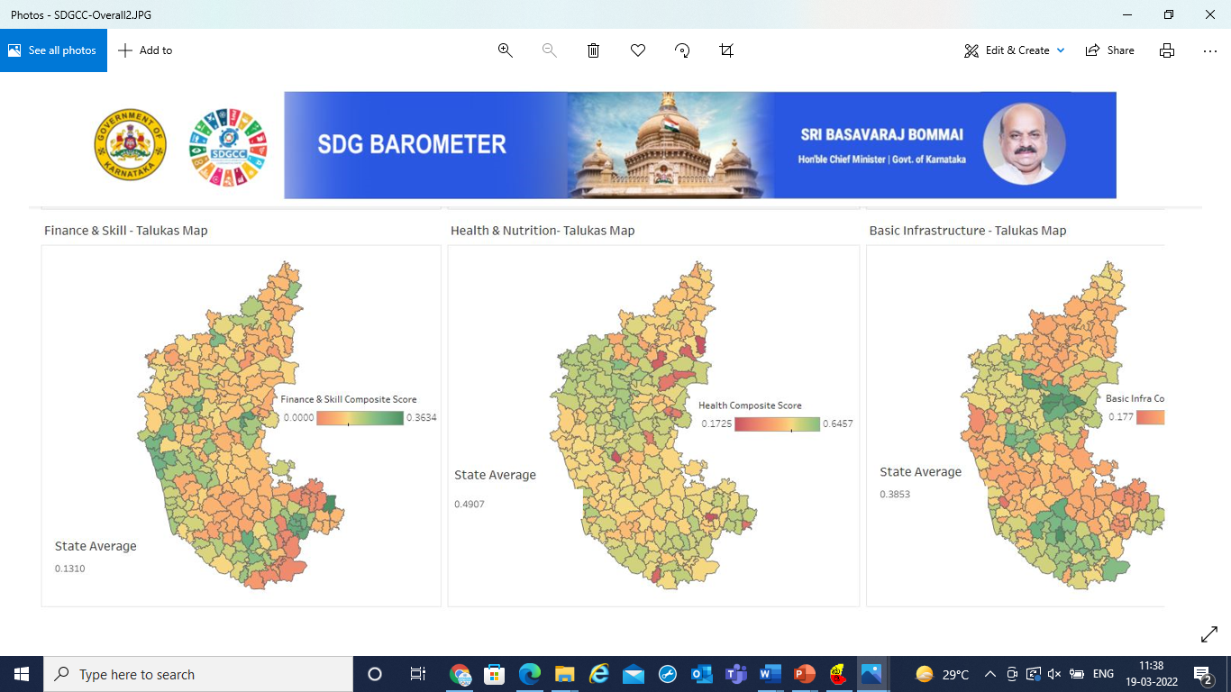

Slide 10
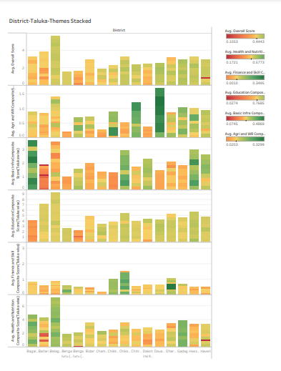

Slide 11
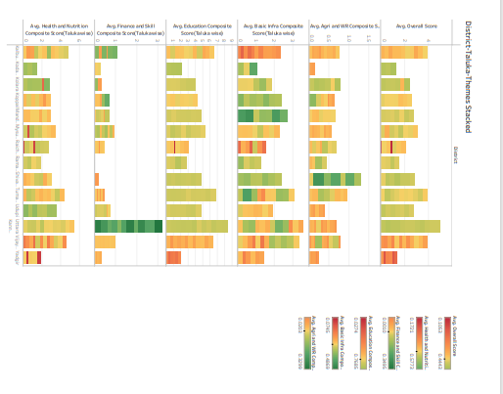

Slide 12
Theme based SDGs for GPs
SDGs are to be mapped to GP themes that make it relatable to Panchayats and the community.
Sl.No | 9 Themes have been identified for Panchayats | SDGs
1 | Theme 1 Poverty free and enhanced livelihoods village | SDG 1,2 and 8
2 | Theme 2 Healthy village | SDG –2, 3
3 | Theme 3 Child friendly village | SDG – 1, 2, 3, 4 and 5
4 | Theme 4 Water sufficient village | SDG-1, 6
5 | Theme 5 Clean and Green village | SDG – 6, 7, 12, 13, 14 and 15
6 | Theme 6 Self-sufficient infrastructure in village | SDGs 1, 2, 4, 5, 6, 9, 11
7 | Theme 7 Socially secured village | SDG – 1, 2, 5,10 and 16
8 | Theme 8 Village with Good Governance | SDG 16
9 | Theme 9 Engendered Development in village | SDG -1,2,3,4,5 and 8

Slide 13
Targets
Targets | The Vision Statement for each Theme is broken down to Local Targets for the Gram Panchayats to work on. Most Targets link to the National Targets (SDGs). GPs need to be choosing their Targets based on Gram Panchayat priorities. In keeping with National, State and sub-state issues, certain Targets would also be prioritized for Gram Panchayats to also work on.

Slide 14
Indicators
Indicators | Department of Statistics in States along with the other epartments in States would require to take this ownership in States on a continuous basis. The Targets are measured by Indicators. Indicators are to form the Local Indicator Framework. There are 389 Indicators. The LIF is in line with the NIF as would apply at Gram Panchayat level and some LIF are unique to only Gram Panchayat level. Targets and Indicators are to be reviewed annually. The numbers of Targets and Indicators taken up by Gram Panchayats can be different, as it is as per their felt needs. This grouping is to be put together for assessing SDG Achievement

Slide 15
Timeline
Timeline | There are some Targets/Indicators on which immediate action is called for, some which would be in the short, medium & long term. It is necessary to work with Gram Panchayats to take up all 4 time-line targets/indicators, to not only take required actions in early years for long term outcomes, as also to bring in the attention to matters/issues immediate
Choice of Indicators, targets, sub goals, Themes | Baseline data on all indicators needs to be collected in the year 2021-22 or at the earliest. From this the data on chosen indicators is to be surely collected and updated annually based on Data source for it to assess change/progress Target values would need to be fixed for some Indicators in the LIF Based on - Block Indicator Framework at Block level and District Indicator Framework at District level

Slide 16
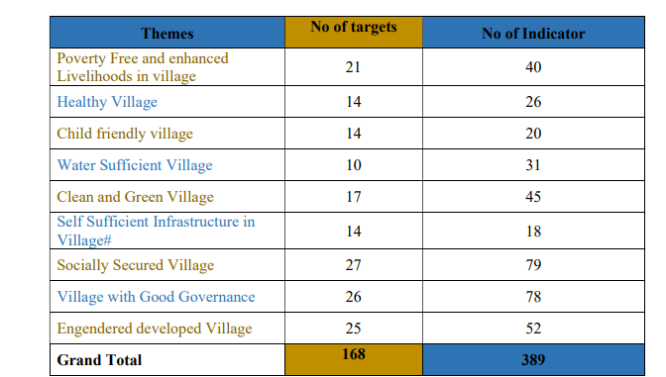
Theme, Targets and Indicators of SDGs for GPs

Slide 17
SDG Dashboard
Dashboard to be developed - incorporate all the identified indicators at GP level to measure progress toward localization of SDGs.
It should include targets, timeline, rationale, limitations, and data sources.
It should enable cross-comparison among District/Taluka/GP and with similar conditions and trends to uncover examples where best practices may be found
The dashboard will be the information hub of activity on SDGs at the Panchayat level Best practices portal is to be linked to Dashboard
Dashboard need to be the work board for Panchayats to prepare the GPDP
Information from SIRD, State Departments & highlights for special activities by Ministries are to link to Dashboard
High degree of visualization with localized presentation perspective to be ensured
Content management and IT support Team at State & District level with Ministerial/State Departments, IT Team involvement should be there

Slide 18
Best practices and documentation
Key part in the process of Localization of SDGs in Panchayats. It should become a systemic tool systematically used
Ringing out effective processes, developments, insightful, inspirational and thought-provoking issues, motivating action, through this
To be used Capacity building & IEC, to bring convergence, yardstick in impact monitoring, evaluation and incentivization, leading change and spurring changes
Best practices online portal giving District, State, Country and International practices, theme wise, sub-goal wise
Community radio, radio, TV, with interviews and video coverages, short films and sponsored programmes in Prasar Bharati, Doordarshan and popular channels can be used for this

Slide 19
Capacity building through SIRD /DTIs & Convergence
Elected Representatives, Committees, GPDP Facilitation Team, Officials and Field functionaries, all partners, and also for all the persons engaged as Resource Persons for the process
ToT - use of digital technology, social media and other modes
Covering online training, videos, T.V, radio, Satcom, etc.,
In Flagship schemes (and other major schemes/programmes), joint IEC program planning to be worked out with IEC teams of Panchayat Raj
Workshops and seminars must be held every month on a Theme, sharing best practice progress and information.

Slide 20
Incentivization on SDGs
Incentivization of the Panchayats for performing best in different themes and addressing issues; in this context, a separate budget to be allocated.
Eg: WCD on Nutrition and Gender related targets, Education for Child friendly panchayat
Fund-pooling as incentives by respective Ministries/Departments for schemes to increase available financing and provision of IEC funds for Panchayats
Sponsored incentives from CSR, local organizations, businesses, private sector to be encouraged and drawn in by Districts & States

Slide 21
Roadmap for Localizing SDGs with PRIs.
States involvement, ease of working with departments for PRIs, developments on dashboard, best practices, capacity Building plans, monitoring mechanisms, incentivization, workshops, seminars, panchayats involved, events, reports, etc.
Appropriate communication and mode for involving Hon’ble Ministers, MPs and MLAs in the Localizing of SDGs in PRIs needs to be decided at both Centre and States
Commence the programme in Aspirational Districts where the existing systems can work to localize SDGs in PRIs as envisaged and add value to grassroots level involvement of ERs, and further enhance progress

Slide 22
Thank you

